Slide 1

ANALYSIS OF SIP, RTP AND RTCP PROTOCOLS
Group-12
Monica Ashok Kumar: 011436815
Nidhi Agarwal: 010728094
Sachin SP: 011425856
Suhas Janardhan: 011169054

Slide 2
Why this Protocol?
Initially only the traditional switch-based telephone system was the main medium for transmitting messages.
Currently, SIP is the de facto standard protocol for establishing, manipulating and terminating VoIP communication sessions which connects people over the IP based network.
The role of SIP within an IP communications network is to allow callers to easily locate their targeted recipients, and deliver session invitations effectively regardless of where the end users are located or what devices they are using.

Slide 3
SIP
Session Initiation Protocol (SIP) is an application layer protocol, which is used to establish, maintain and terminate multimedia session.
SIP runs on TCP, UDP and is designed to be independent of the underlying transport layer.
The first draft for SIP was proposed by IETF in February, 1996, a time when IP telephony did not exist.
In March 1999, SIP published RFC 2543 as a standard.

Slide 4
RTP
The real-time transport protocol (rtp) is an internet protocol standard that specifies a way for programs to manage the real-time transmission of multimedia
Rtp is commonly used in internet telephony applications.
Rtp does not in itself guarantee real-time delivery of multimedia data it does, however, provide the wherewithal to manage the data as it arrives to best effect.
RTCP
Real-Time Transport Control Protocol (RTCP) is a protocol that works with Real-Time Protocol (RTP) to monitor data delivery on large multicast networks.
The purpose of monitoring delivery is to determine whether RTP is providing the necessary Quality of Service (QoS) and to compensate for delays, if needed.
RTCP is used in voice over IP (VoIP) and Internet Protocol Television (IPTV), streaming media and video conferencing.

Slide 5
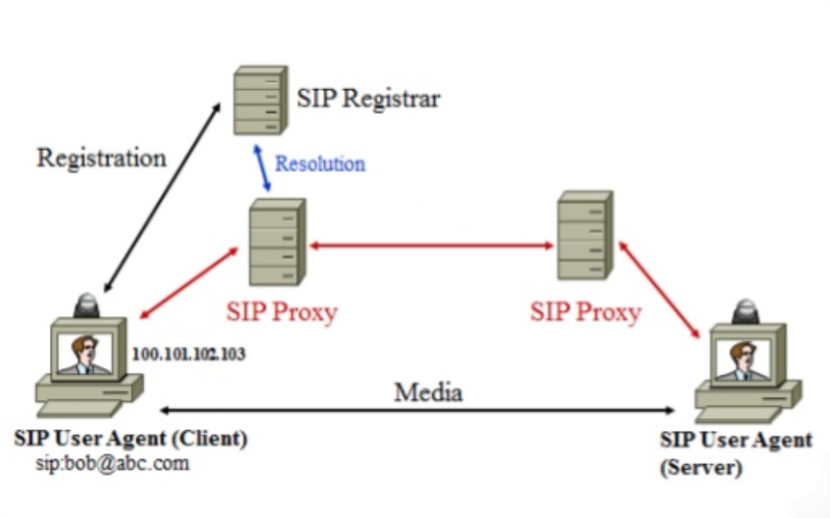
SIP Architecture
The entities that participate in a SIP session are:
User Agents
User Agent Client
User Agent Server
Servers:
Proxy Server
Re-direct Server
Registrar / Location Server

Slide 6
SIP Messages
SIP is a text-based protocol with syntax similar to that of HTTP. There are two different types of SIP messages:
Requests
Requests initiate a SIP transaction between two SIP entities for establishing, controlling, and terminating sessions. The requests are called methods in SIP. The SIP request message consists of a request line which includes: a method token, a request URI and SIP version
Responses
Responses are sent by the user agent server indicating the result of a received request. These responses have borrowed the response codes from HTTP.

Slide 7
SIP Requests
There are fourteen SIP Request methods of which the first six are the most basic request / method types:
Method | Description
OPTIONS | Ask for server capabilities
REGISTER | Sends user’s address to server
INVITE | Used to set up an SIP session
ACK | Confirms a success response to an INVITE. The third part to a three-way- handshake.
CANCEL | Cancels an open request. BYE should be used to cancel (tear down) an existing request.
BYE | Terminates an open session.

Slide 8
SIP Response
Responses are sent by the user agent server indicating the result of a received request. These responses have borrowed the response codes from HTTP. Several classes of responses are recognized, determined by the numerical range of result codes:
Code | Message | Comments
1XX | information message | 100 Trying
2XX | Successful | 200 OK
3XX | Redirection | 302 Moved Temporarily
4XX | Client Error | 404 Not Found
5XX | Server Error | 504 Server Time-out
6XX | Global Failure | 603 Decline

Slide 9
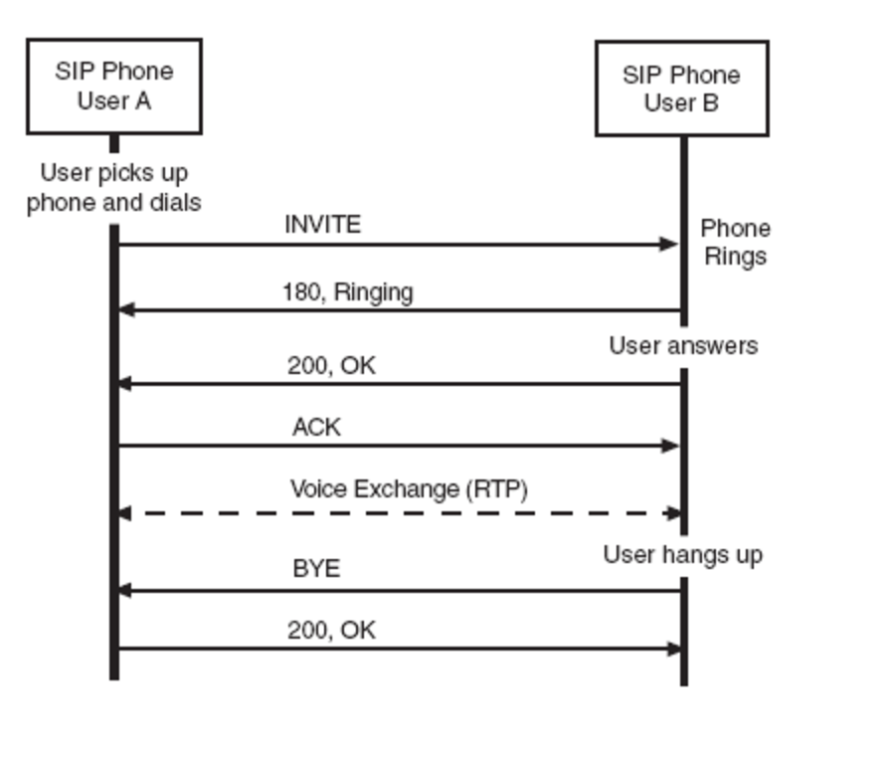
Basic SIP call scenario

Slide 10
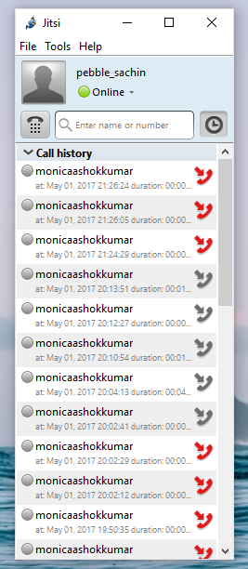
Lab Setup
We have made use of Jitsi application for analyzing SIP.
Jitsi is an open source videoconferencing and instant messaging application for Linux, Windows, Android and Mac OS X. It supports telephony protocols, video/voice streaming and conferencing like SIP, RTP/RTCP etc.
Jitsi gives us options to setup multiple accounts. We have created a SIP account for our lab setup.

Slide 11
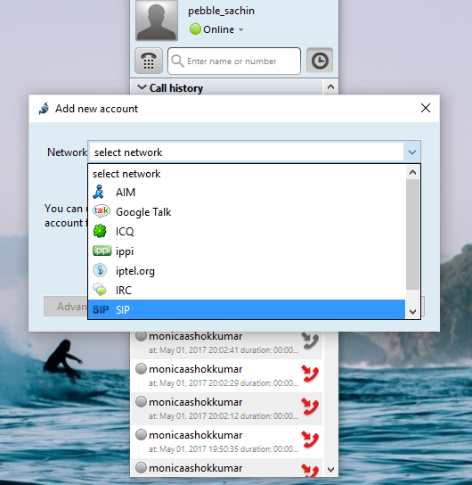
Jitsi gives us options to setup multiple accounts. We have created a SIP account for our lab setup.

Slide 12
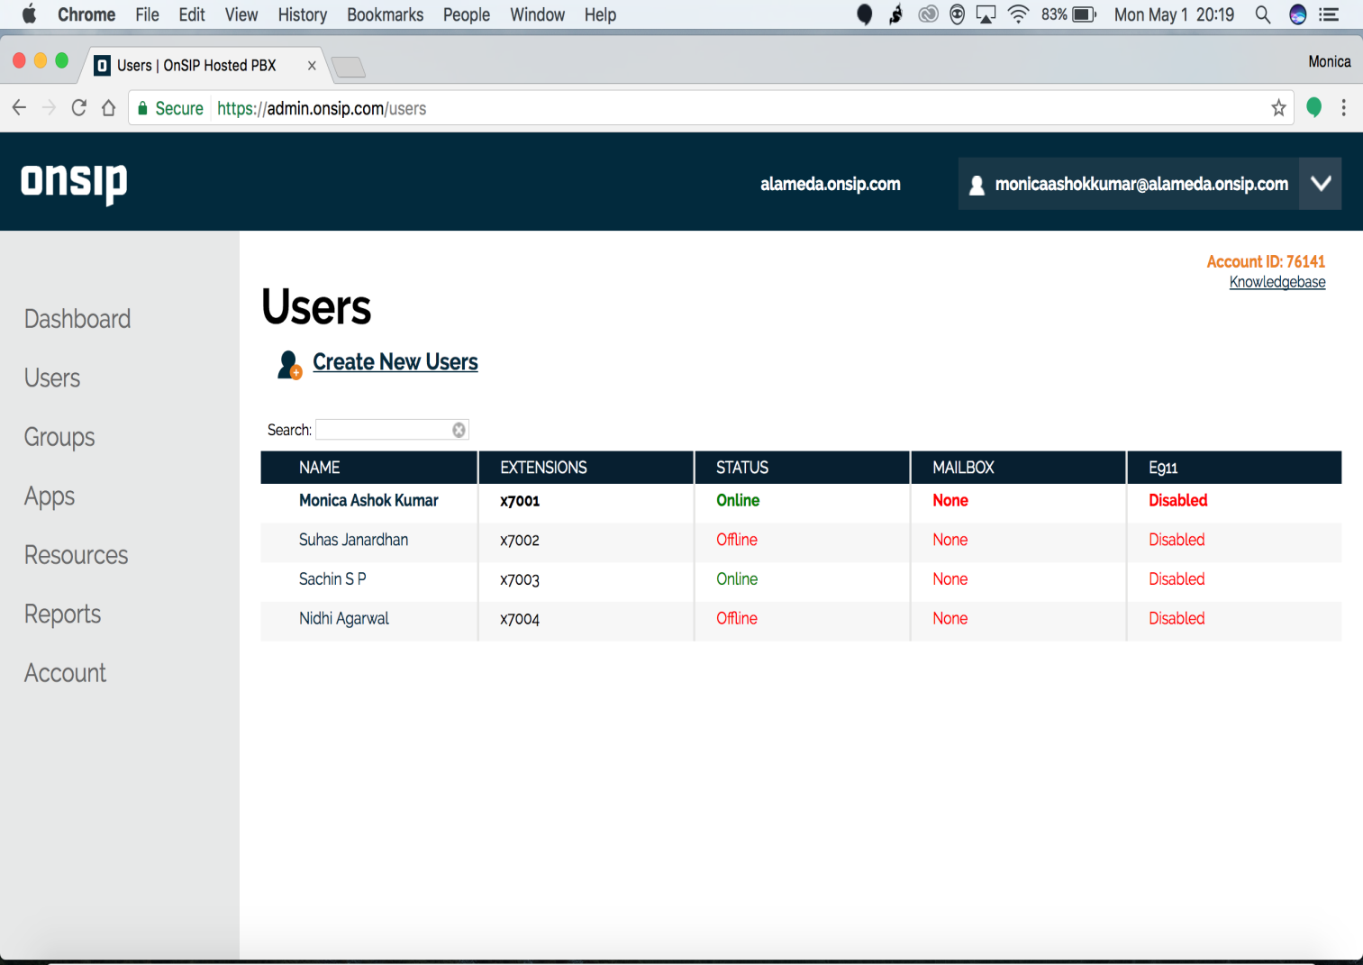
In order to use the Jitsi application or any other voip applications we need to have a dedicated domain. We have made use of “Onsip.com” which provides a free domains.

Slide 13
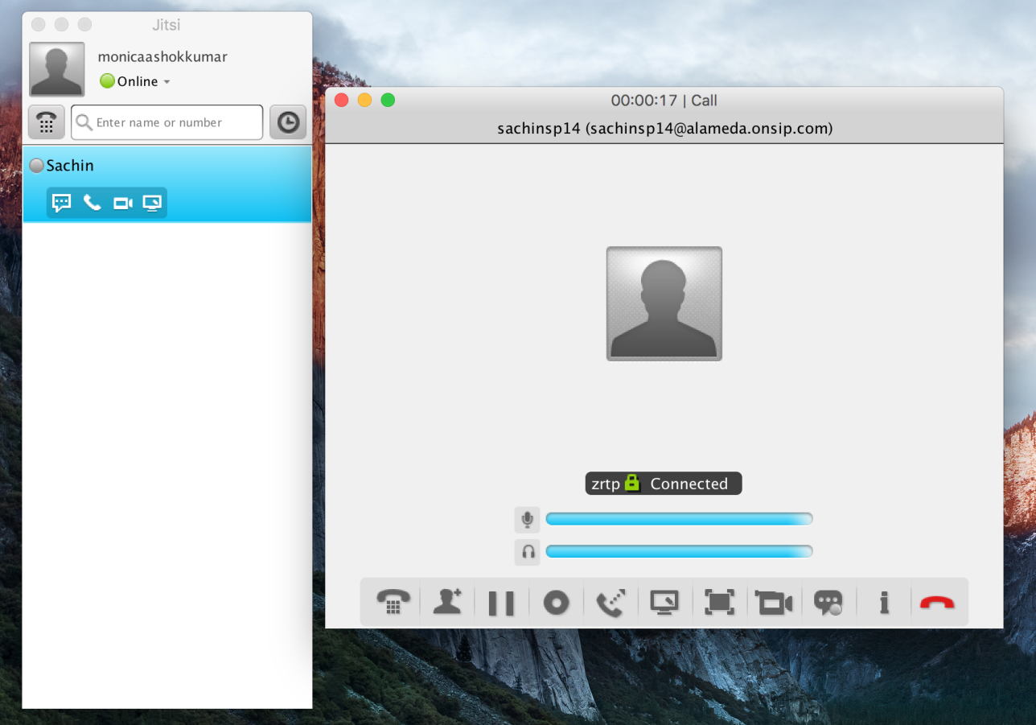
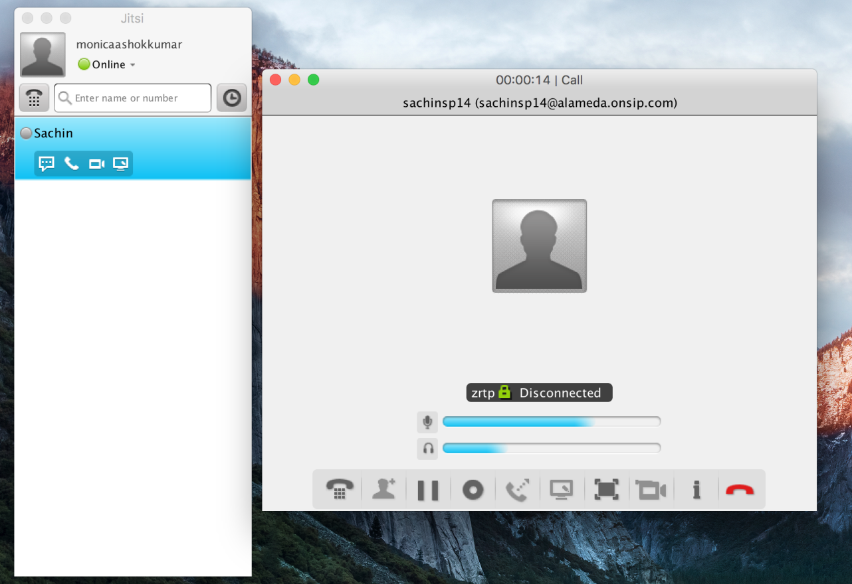
Call Setup
Both video and voice calls were made and different SIP messages were observed and analysed using the Wireshark. Call flow Sequence was also analysed for various scenarios like Busy, Cancel, Complete calls.

Slide 14
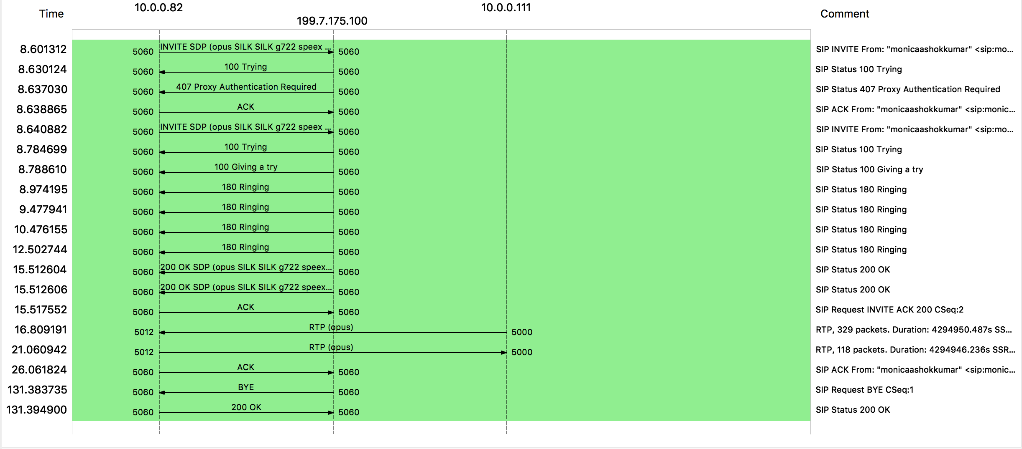
Basic SIP call scenario captured

Slide 15
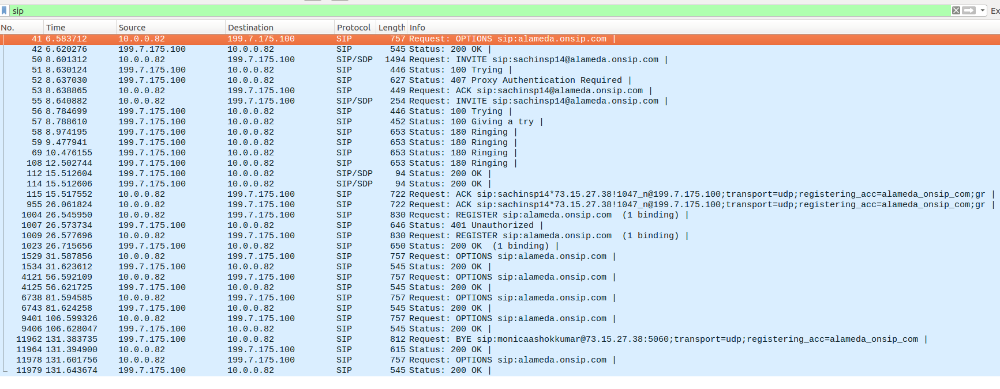
SIP Messages
Analysis of different SIP messages during the call between two users analysed using wireshark.

Slide 16
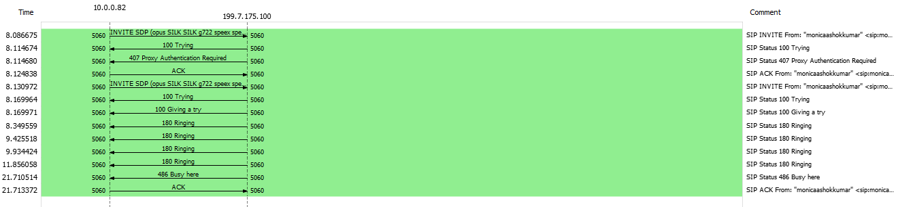
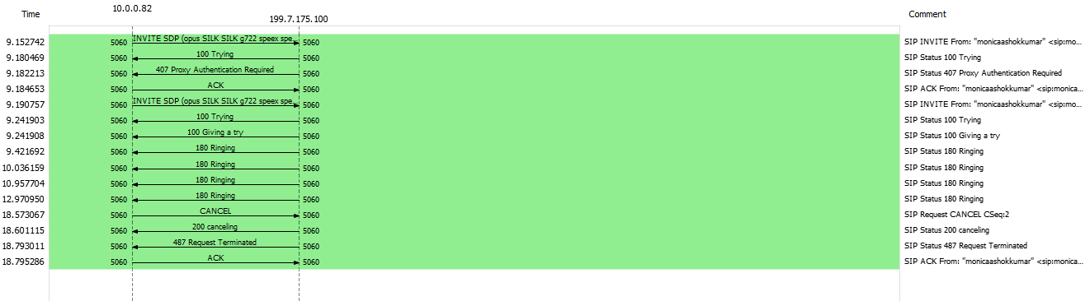
SIP Call Flow Sequence
Call flow sequence was analysed using wireshark for different call scenarios like busy, cancel and a complete call.

Slide 17
SIP Attacks
Flooding Attack:
One of the cardinal network elements in SIP telephony service is the registrar. In this attacker launches an attack against a registrar by employing a large number of registration requests, he/she aims to accomplish one of the two goal: to guess legitimate users’ passwords or to cause a DoS in the SIP registrar.
Parser Attack:
In these kind of attacks the intruder builds a malformed message and tries sending to the target and when the target receives this kind of malformed messages it might crash or result in improper behavior.

Slide 18
SIP Attacks Continued
Message Flows Attack
Message ﬂow attacks are the attacks made on the message ﬂow of SIP. The main reason for attacker to launch attacks by these messages is the lack of authentication or improper authentication mechanism by the SIP participants. These kind of message attacks may result in DoS and improper billing scenarios.
DNS Blocking Attack
An attacker sends messages including irresolvable host names, forcing the underlying DNS service to perform time-consuming, but unsuccessful host lookups. Generally, while the SIP agent waits for the reply from the DNS subsystem, it cannot process other pending messages, which renders it at this moment highly vulnerable to flooding attacks.

Slide 19
Learnings
1.SIP is application layer protocol which is used to create sessions for transmission of media information.
2.RTP protocol is used to send the media packets.
3.RTCP is used for control information of RTP and statistics information.
4.Understood the complete flow of methods and packet contents of SIP.
5.SIP is only associated with signaling, initiation and maintaining information of the call and is not associated with any QOS related to the VOIP call.

Slide 20
Contribution of Team Members
Nidhi Agarwal: Analysis of the SIP Architecture. How does SIP work
Monica Ashok Kumar: Lab Setup and Execution and Analysis using Wireshark
Sachin SP: Lab Setup and Execution and Analysis using Wireshark
Suhas Janardhan: Analysis of SIP messages and SIP attacks. Explored on which application to use for Lab Execution.

Slide 21
Conclusion
SIP has been used for services related to Voice over Internet Protocol. SIP helps in creating and terminating the sessions to transfer the media information between the users. It helps in communication between user agents who doesn’t know about each others location. This project helped us to learn and analyze the SIP, RTP/RTCP there components, message flow, attacks in detailed manner.

Slide 22
Reference
https://www.researchgate.net/publication/309148470_Defending_against_common_attacks_in_SIP
http://searchnetworking.techtarget.com/definition/Real-Time-Transport-Protocol

